Slide 1

Building an Efficient Product Recommender System - Paper ID: 227
Dr.Nagaratna P. Hegde, Dr. V. Sireesha, Sriperambuduri Vinay Kumar, Hasini Reddy Patlolla, Dr. G. P Hegde.
Vasavi College of Engineering, Hyderabad, India & SDM Institute of Technology
6th Edition of International Conference on Communications and Cyber-Physical Engineering

Slide 2
Table of Contents
Introduction
Basic Recommender System
Collaborative Filtering
Implementation
Results
Benefits of an Efficient Product Recommender System
Challenges and Limitations
Conclusion
References
6th Edition of International Conference on Communications and Cyber-Physical Engineering

Slide 3
Introduction
Building an efficient product recommender system is crucial for e-commerce websites to improve customer satisfaction and increase sales. This research paper focuses on the user-based collaborative filtering method, which utilizes the similarities between users' preferences to recommend products that a particular user might be interested in.
The result of this system is to recommend the top five products to the user based on their previous purchases or browsing history.
6th Edition of International Conference on Communications and Cyber-Physical Engineering

Slide 4
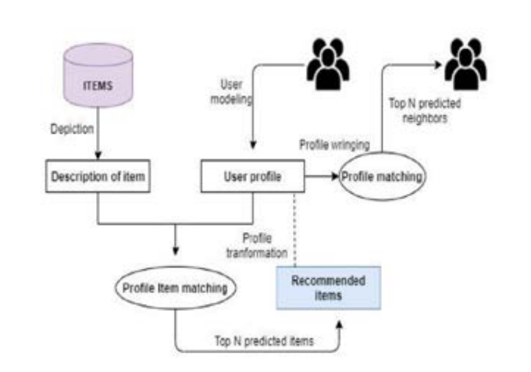
Basic Recommender System
6th Edition of International Conference on Communications and Cyber-Physical Engineering

Slide 5
Collaborative Filtering
Collaborative filtering is a popular technique used in recommender systems. It works by analyzing user behavior and recommending products that other similar users have liked or purchased. Collaborative filtering can be further divided into two types: user-based and item-based.
User-based collaborative filtering recommends products to a user based on the preferences of other similar users. Item-based collaborative filtering, on the other hand, recommends products to a user based on the similarity between the items they have liked or purchased.
6th Edition of International Conference on Communications and Cyber-Physical Engineering

Slide 6
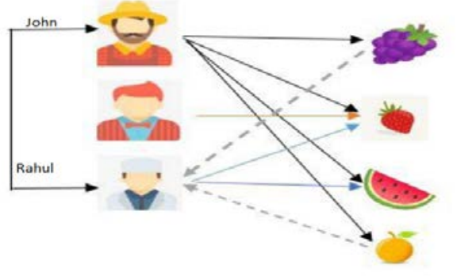
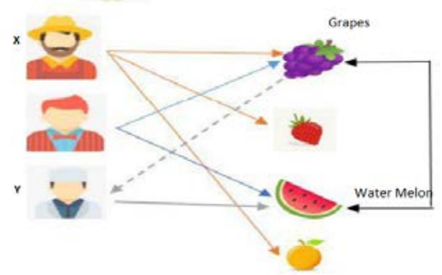
User-Based Collaborative Filtering
Item-Based Collaborative Filtering
6th Edition of International Conference on Communications and Cyber-Physical Engineering

Slide 7
Implementation
This paper illustrates an efficient product recommender system built with user-based collaborative filtering. It follows 11 steps, from importing libraries to evaluating the recommendation model. The result is recommending the top 5 products to the user.
6th Edition of International Conference on Communications and Cyber-Physical Engineering

Slide 8
11 Stages
Importing libraries and modules
Loading dataset and adding headers
Handling missing values
Taking a small subset of the dataset to make it less sparse/dense
Splitting the data
Building Popularity Recommender Model
Building Collaborative Filtering Recommender Model
Introducing User-Based Collaborative Filtering Model
Performing Singular Value Decomposition (SVD)
Evaluating the Collaborative Recommendation Model Getting
Top K (K=5) recommendations
6th Edition of International Conference on Communications and Cyber-Physical Engineering

Slide 9
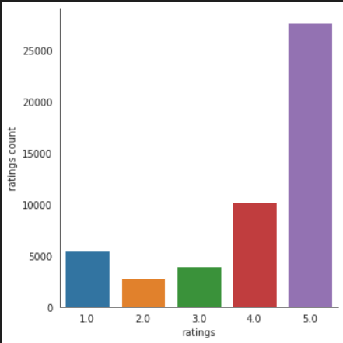
Results
Fig 1. Plotting ratings and their respective counts
6th Edition of International Conference on Communications and Cyber-Physical Engineering

Slide 10
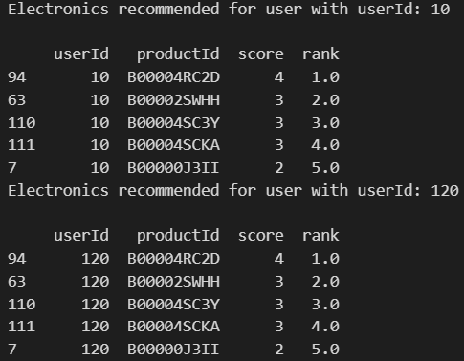
Fig 2. Recommendations from popularity-based recommender model
6th Edition of International Conference on Communications and Cyber-Physical Engineering

Slide 11
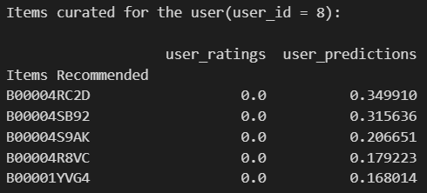
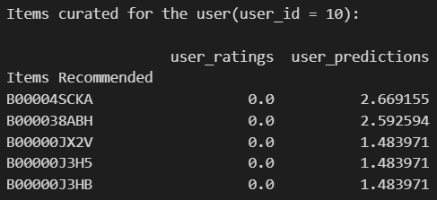
Items curated for user id 8
Items curated for user id 10
Fig 2. Recommendations from User-based collaborative filtering recommender model
6th Edition of International Conference on Communications and Cyber-Physical Engineering

Slide 12
Benefits of an Efficient Product Recommender System
An efficient product recommender system can benefit both the e-commerce website and the customer. For the website, it can increase sales by recommending products that the customer is more likely to purchase. For the customer, it can improve their overall shopping experience by providing personalized recommendations and saving time on searching for products.
Furthermore, an efficient product recommender system can also lead to increased customer loyalty and retention, as customers are more likely to return to a website that provides them with relevant and personalized recommendations.
6th Edition of International Conference on Communications and Cyber-Physical Engineering

Slide 13
Challenges and Limitations
Despite the benefits of an efficient product recommender system, there are also challenges and limitations to consider. One challenge is the issue of cold start, where the system has limited data on new users or products and thus cannot provide accurate recommendations.
Additionally, the system may also suffer from the problem of overspecialization, where the recommendations become too narrow and fail to offer diverse options to the customer.
6th Edition of International Conference on Communications and Cyber-Physical Engineering

Slide 14
Conclusion
In conclusion, building an efficient product recommender system using user-based collaborative filtering method can greatly benefit e-commerce websites and customers alike. While there are challenges and limitations to consider, advancements in technology and machine learning algorithms can help to overcome these obstacles and improve the efficiency of the system.
By providing personalized and relevant recommendations, an efficient product recommender system can enhance the overall shopping experience for customers and ultimately lead to increased sales and customer loyalty.
6th Edition of International Conference on Communications and Cyber-Physical Engineering

Slide 15
References
[1] Rana, Avi, Deeba, K, “Online Book Recommendation System using Collaborative Filtering” International Conference on Physics and Photonics Processes in Nano Sciences, (2019).
[2] Dharna Patel, Jitendra Dangra “A Book Recommendation System for Cloud Computing: A Survey”, International Journal of Computer Applications (2017)
[3] Kurmashov, Nursultan; Latuta, Konstantin; Nussipbekov, Abay,” Online Book Recommendation System”, IEEE (2015)
[4] G.Naveen Kishore, V.Dhiraj , Sk Hasane Ahammad Sivaramireddy Gudise, Balaji Kummara, Likhita Ravuru Akkala “Online Book Recommendation System”, international journal of scientific & technology research , (2019).
[5] Pijitra Jomsri, “Book Recommendation System for Digital Library Based on User Profiles by Using Association Rule” , IEEE Fourth International Conference on Innovative Computing Technology (INTECH), 2014
6th Edition of International Conference on Communications and Cyber-Physical Engineering

Slide 16
THANK YOU

